Slide 1
Dashboard
Ali Youssef Ali
18101591

Slide 2
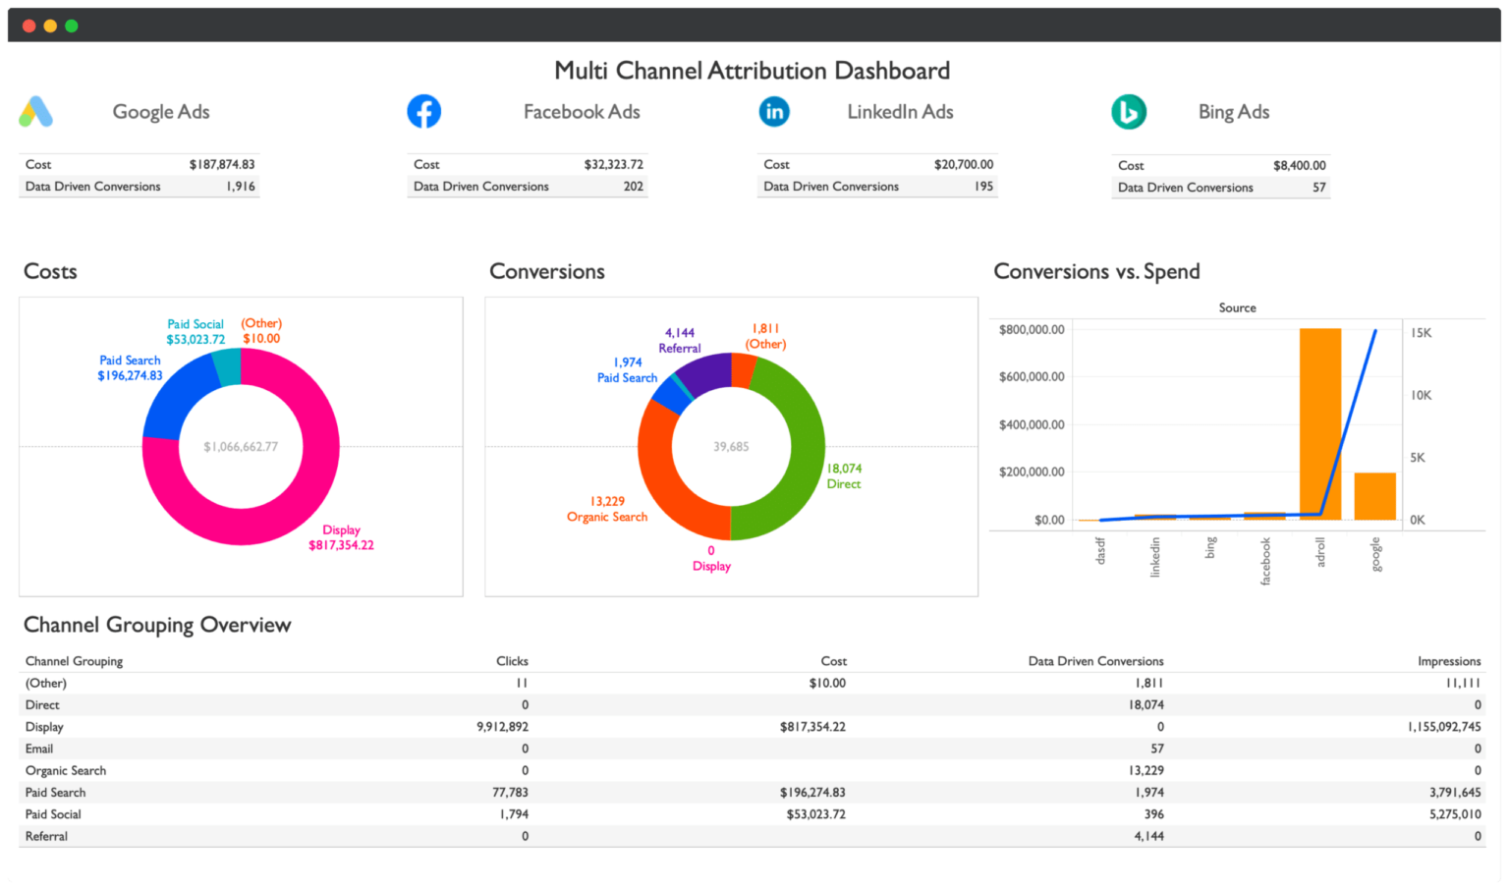

Slide 3
What is Dashboard
A dashboard is a visual display of all of your data. While it can be used in all kinds of different ways, its primary intention is to provide information at-a-glance, such as KPIs. A dashboard usually sits on its own page and receives information from a linked database.

Slide 4
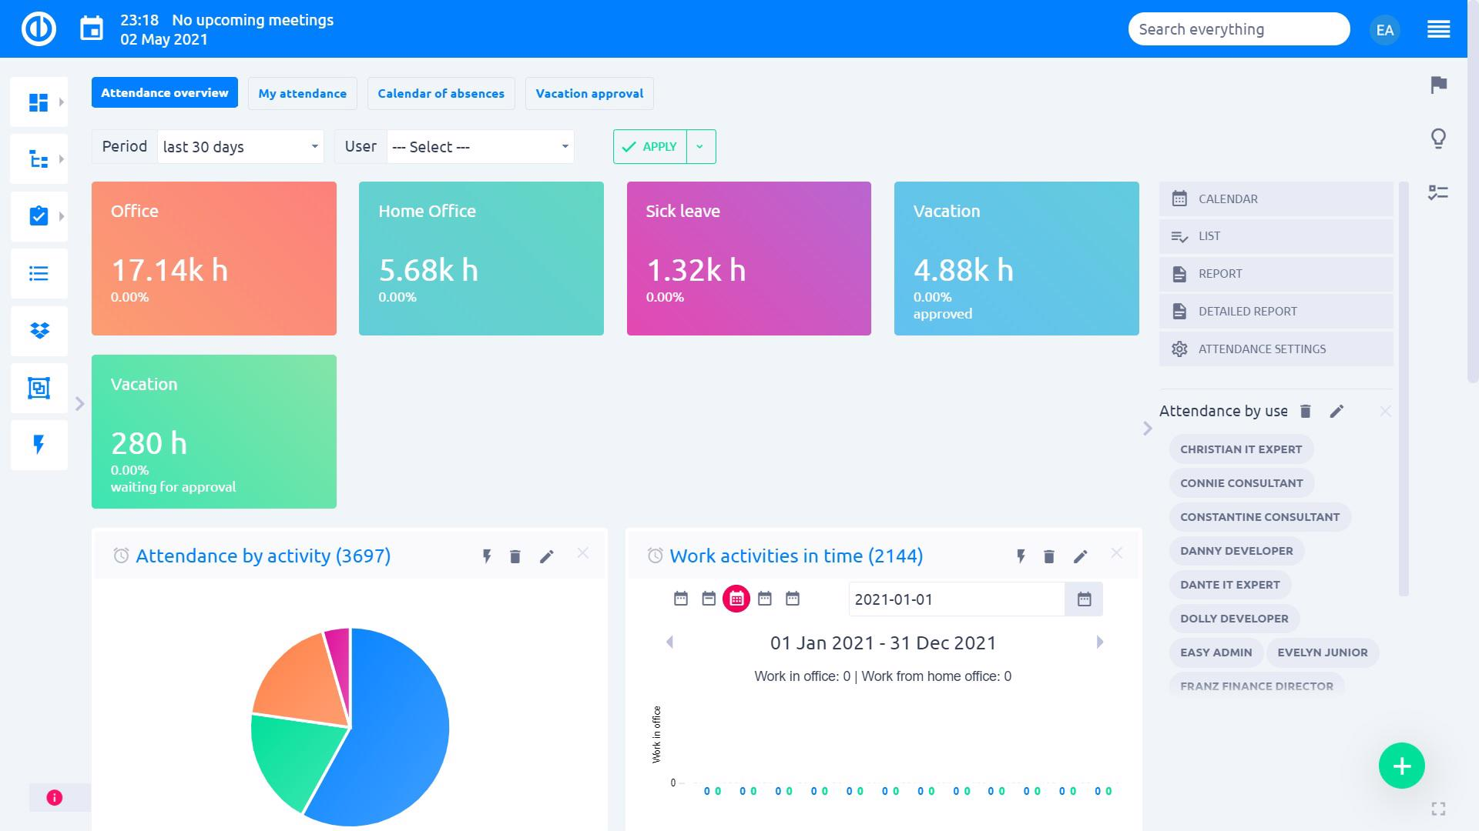

Slide 5
The advantages and benefits of good Dashboard
Dashboards are design to be intuitive to any user. The graphic design allows an easy and smooth navigation throughout the information. Mobile device accessible. - Most dashboards software are programmed to suit any mobile device.

Slide 6
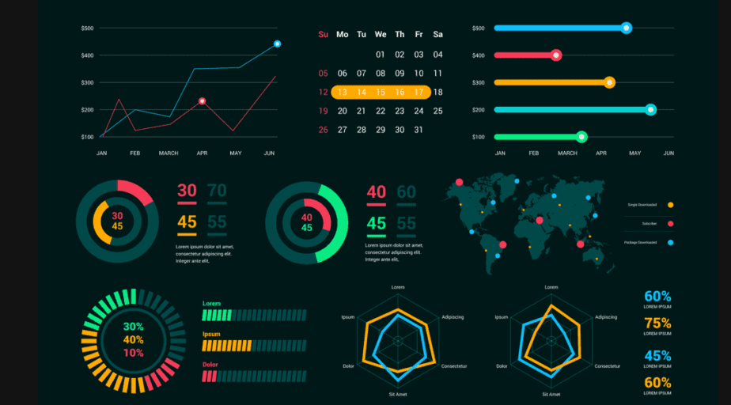

Slide 7
Why Dashboard is important for any career
It’s hard to think of a professional industry that doesn’t benefit from making data more understandable. Every STEM field benefits from understanding data—and so do fields in government, finance, marketing, history, consumer goods, service industries, education, sports, and so on. While we’ll always wax poetically about data visualization (you’re on the Tableau website, after all) there are practical

Slide 8
The different types of Dashboards
operational,
strategic,
and analytical

Slide 9
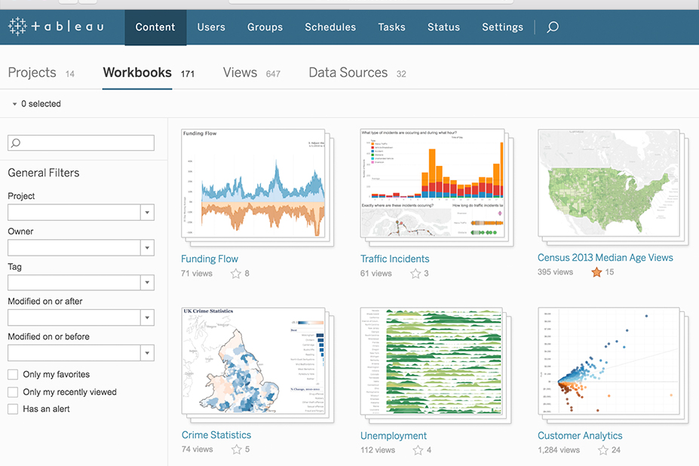

Slide 10
Why is Dashboards important?
Dashboards are vital to IP decision making
IP Professionals use dashboards to quickly gain insights into the most important aspects of their data. They get real time insights and competitive analyses, and use them to identify items that require urgent action, streamlining workflows and properly purposing resources.

Slide 11
How To Design A Dashboard
1. Consider your audience
Concerning dashboard best practices in design, your audience is one of the most important factors you have to take into account. You need to know who's going to use the dashboard and for what purpose they will use it in order to create the best analytical tool for them.

Slide 12
How To Design A Dashboard
2. Determine your goals
The next dashboard UI design principle has a direct relationship between the user's needs and the purpose of the dashboard, which is to establish your ultimate goals. Rather you are creating a client dashboard or an internal report, each dashboard that you create will serve a purpose and answer key questions through the data. Here, it is important to consider that not all the data available will be useful for the analysis process and that getting this part of the process wrong can render your further efforts meaningless.

Slide 13
How To Design A Dashboard
3. Choose relevant KPIs
For a truly effective KPI dashboard design, selecting the right key performance indicators (KPIs) for your business needs is a must. Once you’ve determined your ultimate goals and considered your target audience, you will be able to select the best KPIs to feature in your dashboard.

Slide 14
How To Design A Dashboard
4. Tell a story with your data
Following the workflow for effective dashboard design UX comes the moment to start building your data storytelling.
To put it simply, dashboard storytelling is the process of presenting data in a visual manner that will depict the whole narrative of the data analysis process in order to efficiently understand business strategies and goals. In other words, efficient storytelling will help you communicate your message in the clearest way possible.

Slide 15
How To Design A Dashboard
5. Provide context
Without providing context, how will you know whether those numbers are good or bad, or if they are typical or unusual? Without comparison values, numbers on a dashboard are meaningless for the users. And more importantly, they won’t know whether any action is required. For example, a management dashboard design will focus on high-level metrics that are easy to compare and, subsequently, offer a visual story.

Slide 16
How To Design A Dashboard
6. Don’t try to place all the information on the same page
The next in our rundown of dashboard design tips is a question of information. This most golden of dashboard design principles refers to both precision and the right audience targeting.

Slide 17
How To Design A Dashboard
7. Select the right type of dashboard
Another best practice to consider is to be aware of the type of dashboard that you want to build based on its analytical purpose. As mentioned in previous points, each dashboard should be designed for a particular user group with the specific aim of assisting recipients in the business decision-making process. Information is valuable only when it is directly actionable.

Slide 18
How To Design A Dashboard
8. Use the right type of chart
We can’t stress enough the importance of choosing the right data visualization types. You can destroy all of your efforts with a missing or incorrect chart type. It’s important to understand what type of information you want to convey and choose a data visualization that is suited to the task.

Slide 19
How To Design A Dashboard
9. Choose your layout carefully
Dashboard best practices in design concern more than just good metrics and well-thought-out charts. The next step is the placement of charts on a dashboard. If your dashboard is visually organized, users will easily find the information they need. Poor layout forces users to think more before they grasp the point,

Slide 20
How To Design A Dashboard
10. Prioritize simplicity
One of the best practices for dashboard design focuses on simplicity. Nowadays, we can play with a lot of options in chart creation and it’s tempting to use them all at once. However, try to use those frills sparingly. Frames, backgrounds, effects, gridlines… Yes, these options might be useful sometimes, but only when there is a reason for applying them.

Slide 21
How To Design A Dashboard
11. Round your numbers
Continuing on simplicity, rounding the numbers on your dashboard design should be also one of the priorities since you don't want your audience to be flooded with numerous decimal places. Yes, you want to present details but, sometimes, too many details give the wrong impression.

Slide 22
How To Design A Dashboard
12. Be careful with colors - choose a few and stick to them
Without a shadow of a doubt, this is one of the most important of all dashboard design best practices.
This particular point may seem incongruous to what we have said up to this point, but there are options to personalize and customize your creations to your preferences.

Slide 23
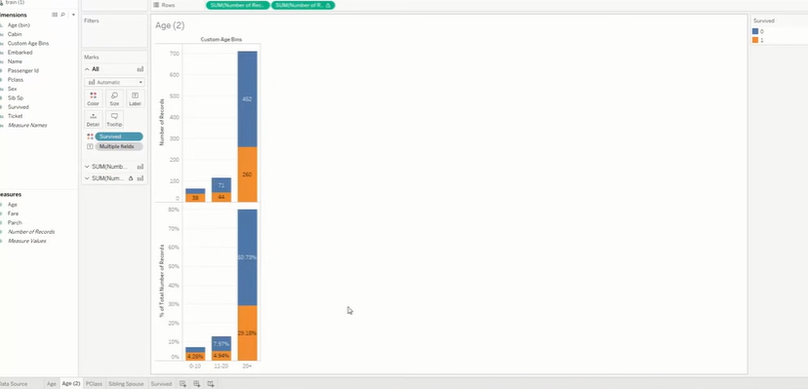

Slide 24
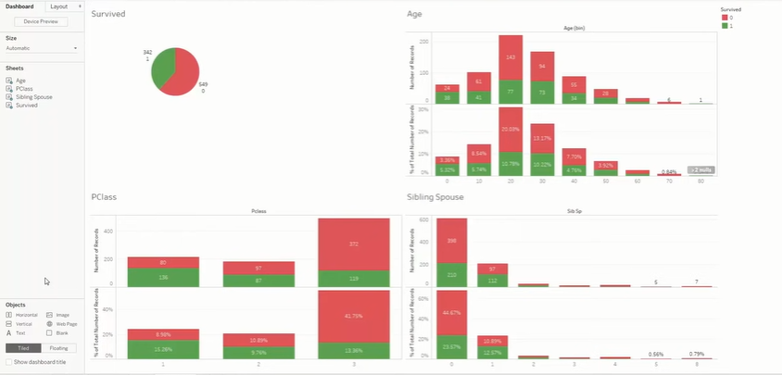

Slide 25
References
https://www.datapine.com/blog/dashboard-design-principles-and-best-practices/
https://blog.azuregroup.com.au/the-importance-of-dashboard-reporting-in-business-why-use-dashboard-reports

